Slide 1
New Perspectives on Creating Web Pages with HTML
Creating a Multimedia Web Page

Slide 2
Tutorial Objectives
Work with external and embedded multimedia files
Learn about the principles of sound and video clips
Work with the <embed> tag to enhance a Web page with sound and video
Provide tags for browsers that do not support embedded objects
Creating Web Pages with HTML, 3e
Prepared by: C. Hueckstaedt, Tutorial 10

Slide 3
Tutorial Objectives Continued
Learn how to create a background sound with Internet Explorer
Use the <applet> tag to add a Java applet to a Web page
Create a scrolling marquee with the <marquee> tag
Creating Web Pages with HTML, 3e
Prepared by: C. Hueckstaedt, Tutorial 10

Slide 4
Working with Multimedia
One of the most important and useful features of the World Wide Web is the ability to present information through the use of sound and video.
One of the primary goals when using multimedia is to create media clips that are compact in size without sacrificing quality.
When creating Web pages that include multimedia elements, you have to consider several factors, not the least of which is the issue of bandwidth.
Creating Web Pages with HTML, 3e
Prepared by: C. Hueckstaedt, Tutorial 10

Slide 5
Bandwidth
Bandwidth is a measure of the amount of data that can be sent through a communications circuit each second.
  bandwidth values range from slow connections, such as phone lines, which can transfer data at a rate of 58.6 kbps to high speed direct network connections capable of transferring data at several megabytes per second
Large sound and video files cause the most trouble for users with low-bandwidth connections.
Creating Web Pages with HTML, 3e
Prepared by: C. Hueckstaedt, Tutorial 10

Slide 6
External Media
With external media, the sound or video file is accessed through a hypertext link.
Using an external file, users can choose to retrieve the multimedia clip.
  useful in situations where a user has a low-bandwidth connection and wants the choice of whether or not to download a large multimedia file
External media is intended for users with low-bandwidth Internet connections i.e. phone lines.
Creating Web Pages with HTML, 3e
Prepared by: C. Hueckstaedt, Tutorial 10

Slide 7
Inline and Embedded Media
Inline media clips are placed into the Web page itself as embedded objects.
  a downside of using inline media is that the user is forced to wait for the clip to be retrieved by the browser
  inline media is intended for users with access to the Web page using a high-speed connection
An embedded media clip works like an inline image and can be played within the Web page itself.
Creating Web Pages with HTML, 3e
Prepared by: C. Hueckstaedt, Tutorial 10

Slide 8
Streaming Audio and Video
Another popular format for sound and video is “streaming” audio and video.
A streaming media file is played as it is downloaded by the Web browser.
  this means you don’t have to wait before viewing the media clip
There are several different streaming audio and video formats. The most popular streaming format for audio files is NetShow, Stream Works, and RealAudio, a companion product is RealVideo.
Creating Web Pages with HTML, 3e
Prepared by: C. Hueckstaedt, Tutorial 10

Slide 9
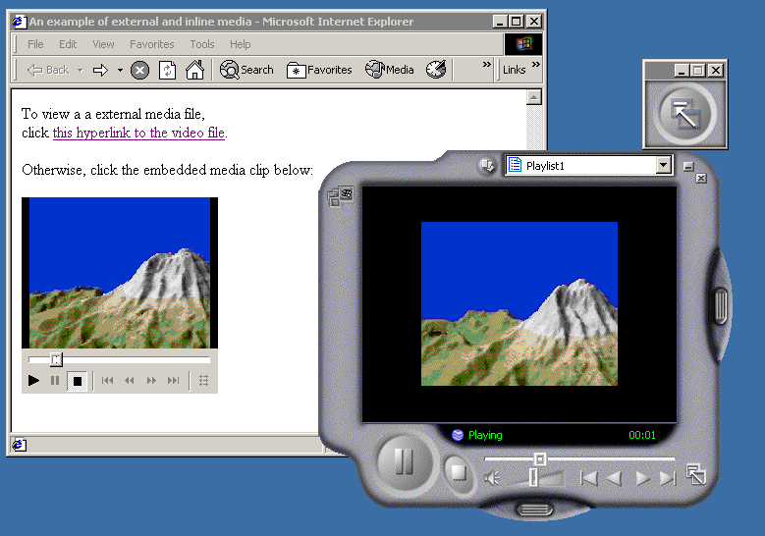

Inline and External Media
This figure shows multimedia can be added to a Web page in one of two ways: as external media or inline media.
inline
external
Creating Web Pages with HTML, 3e
Prepared by: C. Hueckstaedt, Tutorial 10

Slide 10
Understanding Sound Files
Convert sound from the analog form we hear with our ears to the digital form that is stored in files on our computers.
There are two components to the sound wave: amplitude and frequency.
  the amplitude is the height of the sound wave, and it relates to the loudness of the sound
  the frequency is the speed at which the sound wave moves, and it relates to the sound pitch
Creating Web Pages with HTML, 3e
Prepared by: C. Hueckstaedt, Tutorial 10

Slide 11
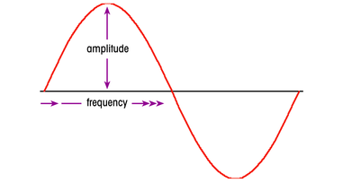
A Simple Sound Wave
This figure shows there are two components to the sound wave: amplitude and frequency.
  the higher the amplitude, the louder the sound
  sounds with high frequency have higher pitches
Creating Web Pages with HTML, 3e
Prepared by: C. Hueckstaedt, Tutorial 10

Slide 12
Sampling Rate
A sound wave is a continuous function.
To convert it to a form that can be stored as a digital sound file, your computer must record measurements of the sound at discrete moments in time.
  each measurement is called a sample
  the number of samples taken per second is called the sampling rate, which is measured in kilohertz (KHz)
  the most commonly used sampling rates are 11 KHz, 22 KHz, and 44KHz
Creating Web Pages with HTML, 3e
Prepared by: C. Hueckstaedt, Tutorial 10

Slide 13
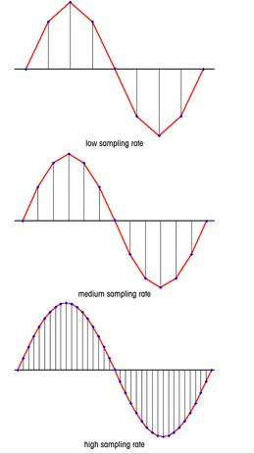
Approximating a Sound Wave with Different Sampling Rates
This figure shows a higher sampling rate means that more samples are taken per second, resulting in a digital sound that more closely matches the analog sound.
The trade-off in increasing the sampling rate is that it increases the size of the sound file.
Creating Web Pages with HTML, 3e
Prepared by: C. Hueckstaedt, Tutorial 10

Slide 14
Sample Resolution
A second factor in converting a sound to a digital form is the sample resolution.
Sample resolution indicates the precision in measuring the sound within each sample.
There are three commonly used sample resolution values 8-bit, 16-bit, and 32-bit.
For most applications, saving sound files at the 16-bit resolution provides a good balance of sound quality and file size.
Creating Web Pages with HTML, 3e
Prepared by: C. Hueckstaedt, Tutorial 10

Slide 15
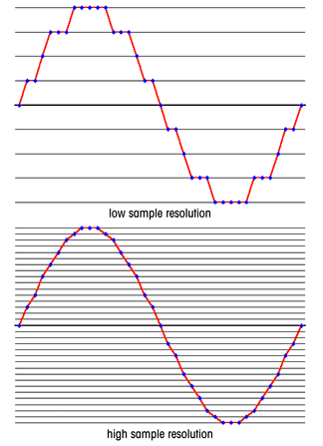
Approximating a Sound Wave at Different Sample Resolutions
This figure shows increasing the sample resolution creates a digital sound file that represents the analog sound in greater detail but, once again, results in a larger file.
Creating Web Pages with HTML, 3e
Prepared by: C. Hueckstaedt, Tutorial 10

Slide 16
Channel Size
A final choice is to determine the number of channels to use.
Typically, the choice is between stereo or monaural (mono) sound.
In some special situations you may want to add extra channels.
Stereo is a richer sound than mono, however, it doubles the size of the sound file.
Creating Web Pages with HTML, 3e
Prepared by: C. Hueckstaedt, Tutorial 10

Slide 17
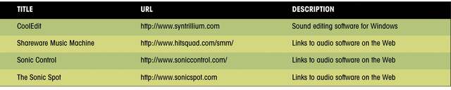
Sampling Rate and Sample Resolution as Related to Sound Quality
This figure shows how sampling rate, sample resolution, and
channel size relate to sound quality in terms of everyday objects.
Your telephone provides the poorest sound quality, and this is a reflection of the low sampling rate and sample resolution as well as the monaural sound.
A CD or DAT player provides much higher sound quality at a higher sampling rate and sample resolution. These players also support stereo sound,
and in some cases, additional sound channels.
Creating Web Pages with HTML, 3e
Prepared by: C. Hueckstaedt, Tutorial 10

Slide 18
Sound Files
To create a sound file, a sound card, speakers, and microphone, and sound-editing software are needed.
There are several sound editors available on the Web that allows you to:
  modify the sampling rate, sample resolution, and number of channels
  to add special sound effects, remove noise, and give you the ability to copy and paste sounds from one sound file to another
Creating Web Pages with HTML, 3e
Prepared by: C. Hueckstaedt, Tutorial 10

Slide 19
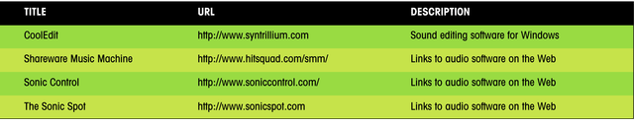
Sound Editing Software on the Web
This figure lists some of the sound editors available on the Web.
Creating Web Pages with HTML, 3e
Prepared by: C. Hueckstaedt, Tutorial 10

Slide 20
Sound File Formats
Several different sound formats are in use on the Web.
The various formats are used by different operating systems and provide varying levels of sound quality and sound compression.
  sound compression is the ability to reduce the size of the digital sound file
Creating Web Pages with HTML, 3e
Prepared by: C. Hueckstaedt, Tutorial 10

Slide 21
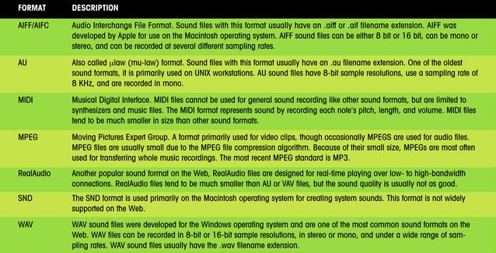
Sound File Formats
This figure lists some of the sound file formats.
Creating Web Pages with HTML, 3e
Prepared by: C. Hueckstaedt, Tutorial 10

Slide 22
Sound File Formats
WAV is one of the most common sound formats on the Web.
For Macintosh systems, consider using either AIFF or SND files.
Web sites designed primarily for UNIX workstations often use the AU sound format.
Creating Web Pages with HTML, 3e
Prepared by: C. Hueckstaedt, Tutorial 10

Slide 23
MP3 Format
The most common sound file format on the Web is MP3.
  a version of the MPEG format that compresses audio files with minor impact on sound quality
The MP3 format uses an open standard.
  allowing for greater innovation from developers creating MP3-related software
MP3 has no security features, making it easier for users to share MP3 files and to attach them to e-mail messages.
MP3 `is readily available in portable music players and car stereos.
Users can convert their MP3 files into WAV format files and burn them onto CDs.
Creating Web Pages with HTML, 3e
Prepared by: C. Hueckstaedt, Tutorial 10

Slide 24
MPEG Format
For larger sound files, such as recordings of complete songs or even concerts, MPEG is the preferred sound format.
The MPEG format has the ability to greatly compress the size of the sound file.
Creating Web Pages with HTML, 3e
Prepared by: C. Hueckstaedt, Tutorial 10

Slide 25
Sound Formats
Sound formats are generally classified into two types nonstreaming and streaming:
  a nonstreaming sound format must be completely downloaded by the user before it can be played
  streaming media is when media clips, including both sound and video, are processed in a steady and continuous stream as they are downloaded by the browser
RealAudio, MP3, WAV, and most other sound formats can now be streamed
Creating Web Pages with HTML, 3e
Prepared by: C. Hueckstaedt, Tutorial 10

Slide 26
MIDI Format
MIDI (Musical Instrument Digital Interface) is a standard for synthesizers and sound cards.
MIDI reduces sound to a series of values that describe the pitch, length, and volume of each note.
MIDI is a widely supported standard.
MIDI files are much smaller than other sound formats.
MIDI is limited to music and cannot be used for general sounds, such as speech.
Creating Web Pages with HTML, 3e
Prepared by: C. Hueckstaedt, Tutorial 10

Slide 27
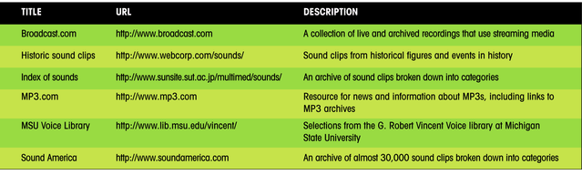
Sound Archives on the Web
Many sites on the Web maintain archives of sound clips that can be downloaded. This figure shows a few of these sites. Be aware that some sound clips have copyright restrictions.
Creating Web Pages with HTML, 3e
Prepared by: C. Hueckstaedt, Tutorial 10

Slide 28
Linking to a Sound File
Media clips tend to be large, it’s a good idea to include information about their format and size in the Web page.
When a browser encounters a link to an external file, it checks to see if there is a program installed to handle the file.
  these programs are called helper applications, because they help the browser interpret and present the file
  if the browser can not display the file, it might display an error message and prompt the user to download one from the Web
Creating Web Pages with HTML, 3e
Prepared by: C. Hueckstaedt, Tutorial 10

Slide 29
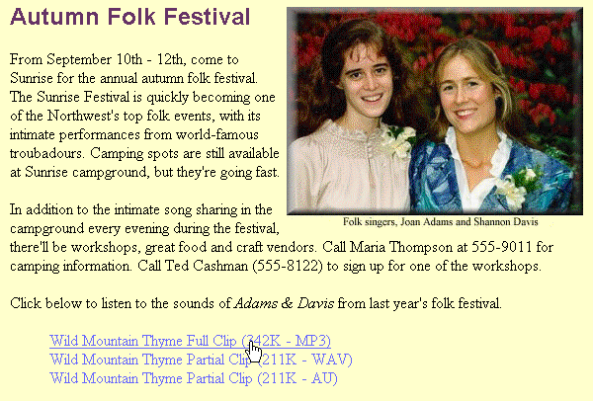

Playing a Multimedia Clip
This figure shows a hypertext link to a MP3 file.
If you are asked to choose whether to open the file or save it, choose to open the sound file. If you are asked to play the sound clip in its own window, you may do that as well.
Creating Web Pages with HTML, 3e
Prepared by: C. Hueckstaedt, Tutorial 10

Slide 30
Embedding a Sound File
A sound clip placed directly into a Web page is one example of an embedded object.
An embedded object is any media clip, file, program, or other object that can be run or viewed from within the Web page.
To use embedded objects, the browser must support them and must have access to the appropriate plug-in applications.
Creating Web Pages with HTML, 3e
Prepared by: C. Hueckstaedt, Tutorial 10

Slide 31
Plug-ins
Plug-ins are programs that enable the browser to work with an embedded object.
When a browser encounters an embedded object, it loads the appropriate plug-in plus any controls needed to manipulate the object.
  for example, a sound file plug-in might place controls on the Web page that enable the user to play the sound clip, pause it, rewind it, or change the volume
Plug-ins require users to download and install additional software before being able to view the Web page.
Creating Web Pages with HTML, 3e
Prepared by: C. Hueckstaedt, Tutorial 10

Slide 32
Plug-ins Continued
There are many plug-ins available for embedded sound clips:
  Netscape provides the LiveAudio and Winamp media player
  Internet Explorer provides the ActiveMovie media player and the Windows Media player
  third-party plug-ins can be used, such as RealPlayer
Creating Web Pages with HTML, 3e
Prepared by: C. Hueckstaedt, Tutorial 10

Slide 33
Using the <embed> Tag
To embed a sound clip into a Web page, use the <embed> tag.
The syntax of the <embed> tag is:
  <embed src=“URL” width=“value” height=“value” align=“value” autostart=“startvalue”>
  URL is the filename and location of the embedded object
  height and width attributes define the size of the embedded object on the Web page
  align attribute defines how text wraps around the embedded clip
  autostart attribute is used to determine whether or not the browser starts the embedded clip automatically when the Web page is loaded
Creating Web Pages with HTML, 3e
Prepared by: C. Hueckstaedt, Tutorial 10

Slide 34
Embedding a Sound File and Browsers
Netscape supports the border, vspace, and hspace attributes, Internet Explorer does not.
The <embed> clip is not part of the HTML 4.01 specifications.
Major browsers support the <embed> clip.
Creating Web Pages with HTML, 3e
Prepared by: C. Hueckstaedt, Tutorial 10

Slide 35
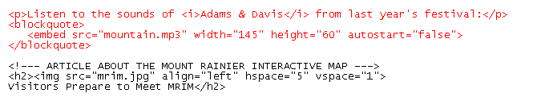
Inserting an Embedded Sound Clip
This figure shows how to insert an embedded sound clip.
embedded sound clip
sound clip does not play automatically
width and height of sound clip controls
Creating Web Pages with HTML, 3e
Prepared by: C. Hueckstaedt, Tutorial 10

Slide 36
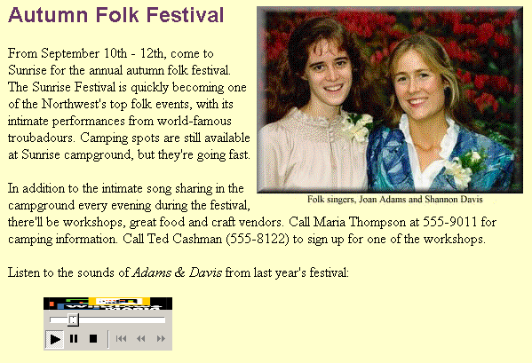
Playing an Embedded Sound Clip
If you do not see any controls for the sound clip on the Web page, it may be because the browser does not support embedded objects.
embedded sound clip and controls (your controls may differ)
Creating Web Pages with HTML, 3e
Prepared by: C. Hueckstaedt, Tutorial 10

Slide 37
Using the <bgsound> Tag
With version 3.0, Internet Explorer introduced a tag for playing background sounds on a Web page.
The syntax of the <bgsound> tag is:
  <bgsound src=“URL” balance=“value” loop=“value” volume=“value”>
  URL is the filename and location of the sound file
  balance attribute defines how the sound should be balanced between the computer’s left and right speakers
  loop attribute defines how many times the sound clip is played in the background
  volume attribute indicates the volume of the background sound
Creating Web Pages with HTML, 3e
Prepared by: C. Hueckstaedt, Tutorial 10

Slide 38
Using the <bgsound> Tag Continued
Background sound displays no control or object on a Web page.
A user cannot stop the background sound from playing, pause it, or rewind it.
The <bgsound> tag should be used with caution.
The <bgsound> tag is not supported by Netscape.
To insert a background sound clip with Netscape, use the following HTML tag:
  <embed src=“file” width=“0” height=“0” autostart=“true”>
Creating Web Pages with HTML, 3e
Prepared by: C. Hueckstaedt, Tutorial 10

Slide 39
Working with Video Files
Displaying video is one of the most popular uses of the Web.
Video files can be exciting and provide lots of information.
Video files can be very large and difficult to work with.
Use a video capture board to record images from a camcorder, television, or VCR.
To create video clips use computer animation software.
Creating a video file can be a time-consuming process.
Creating Web Pages with HTML, 3e
Prepared by: C. Hueckstaedt, Tutorial 10

Slide 40
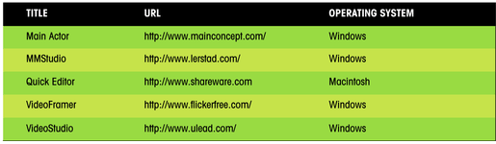
Video-Editing Software
This figure shows some of the video editors you can use to create and work with video files.
Creating Web Pages with HTML, 3e
Prepared by: C. Hueckstaedt, Tutorial 10

Slide 41
Frame Rates
A video file is composed of frames, where each frame represents a single image.
When a video file is played, each frame is shown in sequence, giving the illusion of motion.
The number of frames shown in each unit of time is called the frame rate and is expressed as frames per second (fps).
Working with the frame rate is one way to control the size and quality of a video file.
Another way of controlling the size of the video file is by compressing each frame.
Creating Web Pages with HTML, 3e
Prepared by: C. Hueckstaedt, Tutorial 10

Slide 42
An Example of Frame Rates
For comparison, VHS videotape renders video at the speed of 30 fps, and video files that match this frame rate are usually quite large.
You can reduce the frame rate to reduce the size of the file, this does not slow down the video; instead it:
  reduces the number of frames shown each second
  reduces the total number of frames in the file
    for example, instead of using 30 frames in one second of video, you might be using only 15, which the overall duration of the video clip remains the same, but the size of the file is reduced
Creating Web Pages with HTML, 3e
Prepared by: C. Hueckstaedt, Tutorial 10

Slide 43
Codecs
The technique of compressing and decompressing video frames is called a codec (for compression/decompression).
There are many different codecs, each with its own advantages and disadvantages.
A video editor usually allows you to choose the codec for a video file.
The size of a video file can be reduced by reducing the size of the video frames.
Changing the video from color to grayscale can also reduce the size of a video file.
Creating Web Pages with HTML, 3e
Prepared by: C. Hueckstaedt, Tutorial 10

Slide 44
Video File Formats
Video on the Web typically appears in one of five formats:
  ASF
  AVI
  MPEG
  QuickTime
  RealVideo
Creating Web Pages with HTML, 3e
Prepared by: C. Hueckstaedt, Tutorial 10

Slide 45
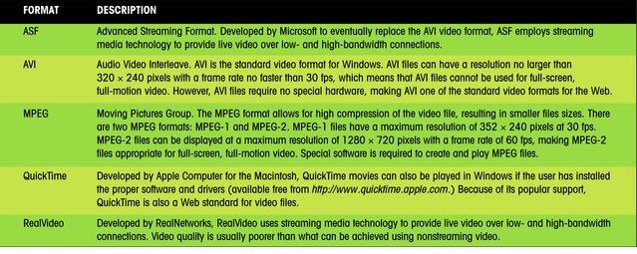
Video File Formats
This figure describes the five formats of video on the Web.
Creating Web Pages with HTML, 3e
Prepared by: C. Hueckstaedt, Tutorial 10

Slide 46
Linking to a Video File
Use the same procedure to link to a video clip as used to link to a sound clip.
Include information about the size of each video file, so that users can determine whether or not they want to retrieve the clip.
Creating Web Pages with HTML, 3e
Prepared by: C. Hueckstaedt, Tutorial 10

Slide 47
Linking to a Video File Continued
A sample code for linking to mrim.avi and mrim.mov video files is:
  <p>Preview a clip from the Mount Rainier Interactive Map.</p>
  <blockquote>
  <a href=“mrim.avi”>Summit Flyby (187K – AVI)</a><br>
  <a href=“mrim.mov>Summit Flyby (215K – QuickTime)</a>
  </blockquote>
Creating Web Pages with HTML, 3e
Prepared by: C. Hueckstaedt, Tutorial 10

Slide 48
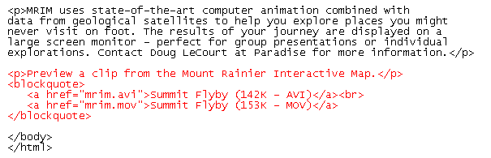
Inserting Hypertext Links to Video Files
Both Internet Explorer and Netscape are capable of displaying AVI and MOV files directly within the browser without the use of plug-ins.
Creating Web Pages with HTML, 3e
Prepared by: C. Hueckstaedt, Tutorial 10

Slide 49
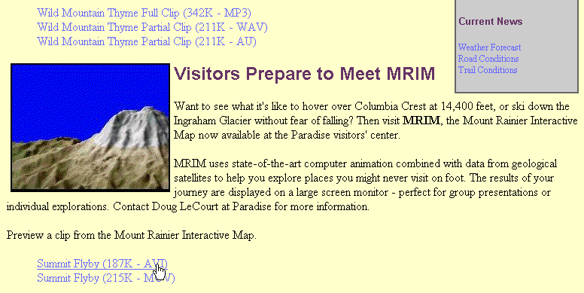
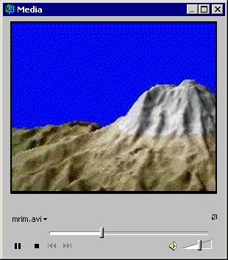
Playing a Video Clip
This figure shows a sample of how a user might access a video clip.
If you are asked to choose whether to open the file or save it, choose to open the video file.
Creating Web Pages with HTML, 3e
Prepared by: C. Hueckstaedt, Tutorial 10

Slide 50
Embedding a Video File
To embed a video file, you can use the <embed> tag.
Specify a source for the embedded video clip with the src attribute.
Specify a size for the clip using the height and width attributes.
  the object’s height and width should be large enough to display any controls needed to operate the clip
  typically, the size is determined by trial and error
Use the autostart tag to specify whether or not to start the clip when the page is loaded.
Creating Web Pages with HTML, 3e
Prepared by: C. Hueckstaedt, Tutorial 10

Slide 51
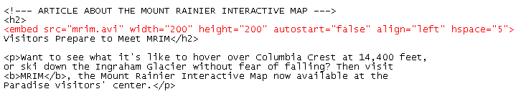
Inserting an Embedded Video Clip
This figure shows how to insert an embedded video clip.
replace the inline image with an embedded clip
Creating Web Pages with HTML, 3e
Prepared by: C. Hueckstaedt, Tutorial 10

Slide 52
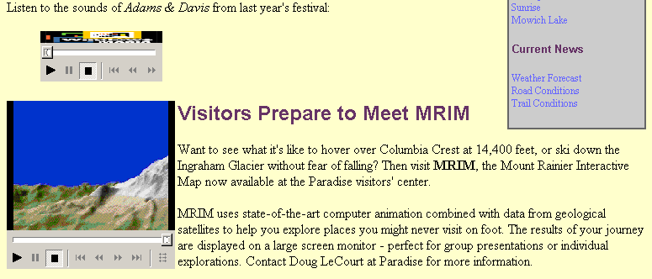
Playing an Embedded Video Clip
This figure shows a sample of an embedded video clip.
embedded video clip and controls (your controls may differ)
Creating Web Pages with HTML, 3e
Prepared by: C. Hueckstaedt, Tutorial 10

Slide 53
Using the <noembed> Tag
Older browsers do not support embedded objects.
The <noembed> tag provides a way to support older browsers that don’t recognize the <embed> tag.
The general syntax of the <noembed> tag is:
<embed attributes>
<noembed>
HTML tags recognized by older browsers
</noembed>
Older browsers will run whatever tags are entered between the <noembed> tags.
Creating Web Pages with HTML, 3e
Prepared by: C. Hueckstaedt, Tutorial 10

Slide 54
Using the dynsrc Attribute
The dynsrc “dynamic source” attribute specifies a video clip that is associated with an inline image.
For example, an inline image that was inserted using the following <img> tag:
  <img src=“file” align=“right” hspace=“5” vspace=“1”>
  Can be replaced using this tag:
  <img dynsrc=“file” src=“file” align=“right” hspace=“5” vspace=“1”>
Using this tag allows you to display a GIF and JPEG image as a “preview” of the inline video clip.
Creating Web Pages with HTML, 3e
Prepared by: C. Hueckstaedt, Tutorial 10

Slide 55
The <img> Tag and dynsrc Attribute
There are other attributes of the <img> tag that you can use along with the dynsrc attribute. These include:
  controls attribute to specify whether to include VCR-like controls beneath the video clip
  loop attribute to specify the number of times the video is played
  start attribute to control how the video clip is started
The dynsrc attribute and its associated attributes are supported only by Internet Explorer, supplement HTML code with the <embed> tag to allow other browsers to use the embedded video clip.
Creating Web Pages with HTML, 3e
Prepared by: C. Hueckstaedt, Tutorial 10

Slide 56
Introducing Java Applets
Java computing language was developed to allow users to run programs from within their Web browsers rather than on the Web server.
Each Java program is called an applet.
  examples of Java applets are stock market tickers, games, animations, and other utilities.
Unlike JavaScript, a Java applet is not inserted into your HTML file, but it is an external file that is downloaded and executed by the browser.
The applet itself is displayed as an embedded object on a Web page in an applet window.
Creating Web Pages with HTML, 3e
Prepared by: C. Hueckstaedt, Tutorial 10

Slide 57
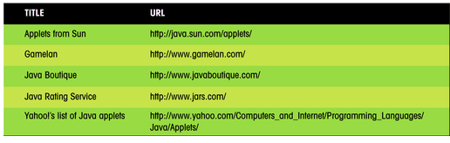
Java Applet Archives on the Web
Many Java applets are available on the Web;
sometimes they are free and sometimes you have to pay for them.
This figure shows a list of a few of the more popular sources for Java applets.
Creating Web Pages with HTML, 3e
Prepared by: C. Hueckstaedt, Tutorial 10

Slide 58
Java Applet
To write your own Java applet, you need a Java Developer’s Kit (JDK).
There are commercial JDKs that provide easy-to-use graphical tools and menus to help create Java applets quickly and easily.
JDK is similar to JavaScript, however, it is a more complicated, and powerful language.
Creating Web Pages with HTML, 3e
Prepared by: C. Hueckstaedt, Tutorial 10

Slide 59
.class File
After you write the code for a Java program, save the source code as a file with the four-letter extension .java.
The file is changed, in a process called compiling, into an executable file that can run by itself without the JDK.
The executable filename has the four-letter extension .class and is called a .class file.
Some Java applets may require several .class files.
A class file can be run only from within a Java interpreter.
In most cases, the Java interpreter is the Web browser.
Creating Web Pages with HTML, 3e
Prepared by: C. Hueckstaedt, Tutorial 10

Slide 60
Working with the <applet> and <param> Tags
Use the <applet> tag to insert the applet into a Web page.
The <applet> tag identifies the .class file used by the applet and allows you to specify any parameters required by the applet.
The general syntax of the <applet> tag is:
  <applet code=“file”>
  <param>
  <param>
  . . .
  <param>
  </applet>
Creating Web Pages with HTML, 3e
Prepared by: C. Hueckstaedt, Tutorial 10

Slide 61
Working with the <applet> and <param> Tags
  file is the filename of the Java applet
  the <param> tags are used for any parameters required by the applet
  The syntax of the <param> tag is:
  <param name=“text” value=“value”>
    name attribute identifies the name of the parameter required by the applet
    value attribute is the value you’ll give the parameter
Creating Web Pages with HTML, 3e
Prepared by: C. Hueckstaedt, Tutorial 10

Slide 62
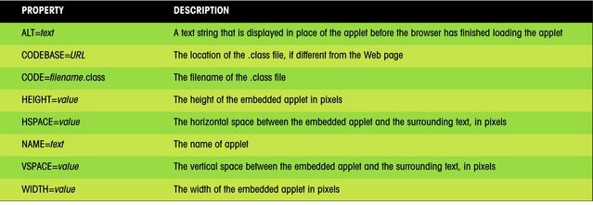
Attributes of the <applet> Tag
This figure shows some of the other attributes supported by the <applet> tag.
Creating Web Pages with HTML, 3e
Prepared by: C. Hueckstaedt, Tutorial 10

Slide 63
The codebase Attribute
The codebase attribute runs an applet placed in a different location than the Web page.
Placing applets in a central location allows you to maintain only one copy of each applet, rather than copies for each Web page.
Makes it easier to manage collections of applets.
Allows you to run someone else’s Java applet from that person’s Web server.
  this practice is discouraged and, in some cases, is a violation of copyright laws
  when using someone else’s Java applet, first obtain permission and retrieve the .class file before placing on your Web server
Creating Web Pages with HTML, 3e
Prepared by: C. Hueckstaedt, Tutorial 10

Slide 64
Insert Other HTML Tags and Text
Older browsers ignore the <applet> and <param> tags and instead display the text specified.
New browsers that support Java applets ignore that text.
Use HTML code to have the browsers display the applet, or if it’s an older browser, the message to upgrade.
Creating Web Pages with HTML, 3e
Prepared by: C. Hueckstaedt, Tutorial 10

Slide 65
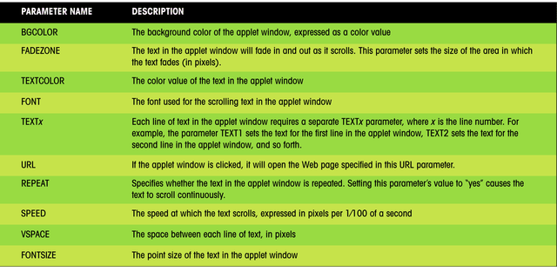
Parameters for Applets
This figure shows a list of some of the parameters for applets.
Creating Web Pages with HTML, 3e
Prepared by: C. Hueckstaedt, Tutorial 10

Slide 66
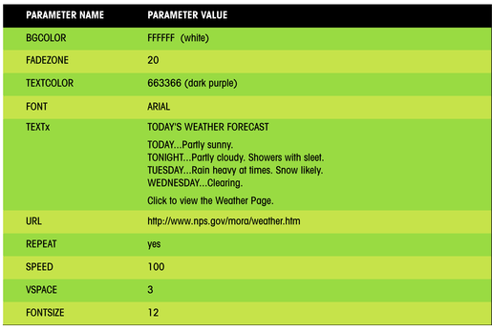
Values for the Creditroll Applet
This figure shows an example of parameters values used to display weather information.
Creating Web Pages with HTML, 3e
Prepared by: C. Hueckstaedt, Tutorial 10

Slide 67
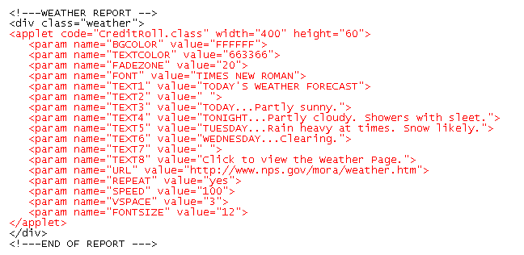
Inserting an Applet and Parameter Values
This figure shows how to insert an applet and parameter values for weather information.
With the large number of embedded objects and the Java applet, this Web page may take a while to load.
filename of Java applet
dimensions of Java applet
applet parameters
Creating Web Pages with HTML, 3e
Prepared by: C. Hueckstaedt, Tutorial 10

Slide 68
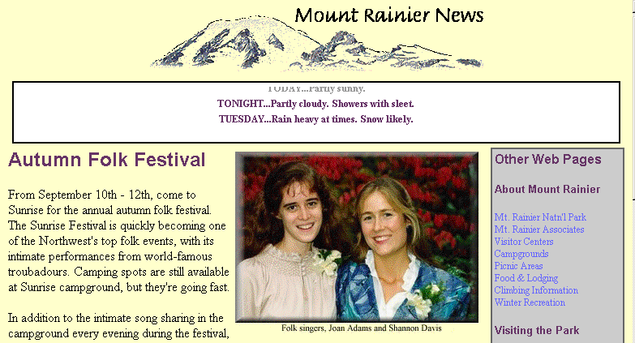
The Applet in Action
text fades as it leaves the applet window
text scrolls vertically
If the browser has trouble accessing the applet, check the <applet> and <param> tags for any errors or misspellings.
Creating Web Pages with HTML, 3e
Prepared by: C. Hueckstaedt, Tutorial 10

Slide 69
Using the Internet Explorer
<marquee> Tag
Use the <marquee> tag to create a theatre-style marquee.
The general syntax of the <marquee> tag is:
  <marquee attributes>Marquee Text</marquee>
  Marquee Text is the text that appears in the marquee box
The <marquee> tag is only supported by Internet Explorer.
Browsers that do not support the <marquee> tag will simply display the entire marquee text without any scrolling.
Creating Web Pages with HTML, 3e
Prepared by: C. Hueckstaedt, Tutorial 10

Slide 70
Attributes of the <marquee> Tag
This figure describes some of the attributes of the <marquee> tag.
Attribute | Description
begin="value" | The time, in seconds, before beginning the marquee. The default is "0”.
behavior="type" | The text behavior within the container. The default value of "scroll" instructs the text to scroll across the container, "alternate" instructs the text to reverse its direction when it reaches the container's edge, and "slide” instructs the text to stop once it reaches the end of the container.
bgcolor="color" | The background color of the container
direction="type" | The direction of the text movement. Options are: "left", "right", "down", or "up). The default is "left".
end="value" | The time, in seconds, before ending the marquee.
height="value" width="value" | The height and width of the marquee container, in pixels
hspace="value" vspace="value" | The horizontal and vertical space around the marquee container, in pixels
loop="value" | The number of times the marquee plays. A value of "0" or "-1" instructs the marquee to play without stopping. The default is "-1".
scrollamount="value" | The distance, in pixels, that the text moves each time the marquee is redrawn. The default is "6".
scrolldelay="value" | The delay, in milliseconds, between subsequent drawings of the marquee. The default is "85".
Creating Web Pages with HTML, 3e
Prepared by: C. Hueckstaedt, Tutorial 10

Slide 71
Using the <marquee> Tag
To control the appearance and size of the marquee, insert the following attributes into the <marquee> tag:
  bgcolor=“color” width=“value” height=“value”
  bgcolor attribute controls the background color of the marquee box
  width and height attributes define the dimensions of the box
To control the placement of the marquee with the surrounding text, use the attributes:
  hspace=“value” vspace=“value”
  hspace and vspace attributes define the amount of horizontal and vertical space in pixels around the box
Creating Web Pages with HTML, 3e
Prepared by: C. Hueckstaedt, Tutorial 10

Slide 72
Using the <marquee> Tag Continued
To control the behavior of text within the marquee, use the attributes:
  Behavior=“type” direction=“type” loop=“value”
  behavior is either “scroll” (to scroll the text across the box), “slide” (to slide the text across the box and stop), or “alternate” (to bounce the text back and forth across the box)
  direction attribute defines the direction the text moves, is “left” (the default), “right”, “down”, or “up”
  loop attribute determines how often the text moves across the box and is either an integer or “infinite”
To control the speed of the text within the marquee, use the attributes:
  Scrollamount=“value” scrolldelay=“value”
  scrollamount is the amount of space, in pixels, that the text moves each time it advances across the page
  scrolldelay is the amount of time, in milliseconds, between text advances
Creating Web Pages with HTML, 3e
Prepared by: C. Hueckstaedt, Tutorial 10

Slide 73
Using the <marquee> Tag Continued
Should restraint in using the <marquee> tag, because they can distract users from other elements on the Web page if used to often.
A continuous marquee can quickly become a nuisance.
Creating Web Pages with HTML, 3e
Prepared by: C. Hueckstaedt, Tutorial 10

Slide 74
Using the <object> Tag
The <object> tag is supported ONLY by Internet Explorer.
There are four types of embedded objects that can exist on a Web page:
  sound clips
  video clips
  applets
In order to deal with these objects in a consistent way, HTML 4.0 introduced the <object> tag, which is used for any embedded object.
Creating Web Pages with HTML, 3e
Prepared by: C. Hueckstaedt, Tutorial 10

Slide 75
Using the <object> Tag Continued
Netscape does not support the <object> tag through version 4.7.
The general syntax for the <object> tag is:
  <object data=“URL” type=“type” classid=“URL” codebase=“URL”>
  <param parameter name and value>
  <param parameter name and value>
  . . .
  Text and tags that are displayed by browsers that don’t support the <object> tag
  </object>
Creating Web Pages with HTML, 3e
Prepared by: C. Hueckstaedt, Tutorial 10

Slide 76
Using the <object> Tag Continued
  data attribute is used to indicate the source of the data for the embedded object
  type attribute indicates the type of data to be embedded (enclosed in quotes)
  classid attribute identifies the class of object being embedded
  codebase attribute indicates the location of the source data, if it differs from the location of the Web page
Creating Web Pages with HTML, 3e
Prepared by: C. Hueckstaedt, Tutorial 10

Slide 77
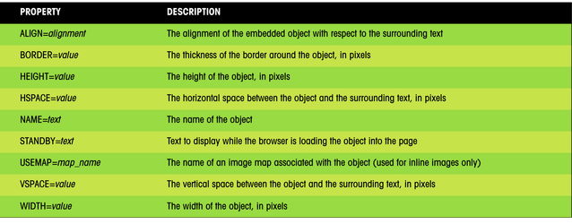
Attributes of the <object> Tag
This figure shows a partial list of the attributes associated with the <object> tag..
Creating Web Pages with HTML, 3e
Prepared by: C. Hueckstaedt, Tutorial 10

Slide 78
Specifying the Type Value
The type attribute is expressed in terms of the MIME data type.
The MIME (Multipurpose Internet Mail Extension) data type was developed to allow e-mail messages to include nontext objects i.e. sound and video files.
MIME was adapted for use on the World Wide Web.
  if a value is not specified for the type attribute, the Web browser may have difficulty rendering the Web page
  if the browser doesn’t support the MIME data type, it will not download the object from the Web server
Creating Web Pages with HTML, 3e
Prepared by: C. Hueckstaedt, Tutorial 10

Slide 79
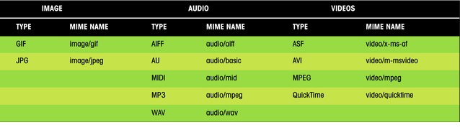
Some Mime Data Types
This figure lists the MIME names for some of the objects embedded in Web pages.
Creating Web Pages with HTML, 3e
Prepared by: C. Hueckstaedt, Tutorial 10

Slide 80
Specifying the classid Value
The classid attribute provides information to the browser on how the object is to be implemented on the Web page.
For inline images, sound files, and video files, you don’t need to specify a value for the classid attribute.
For Java applets, the classid attribute takes the place of the data attribute.
The syntax for embedding a Java applet within the <object> tag is:
  <object classid=“java: filename”>
  <param>
  <param>
  . . .
  </object>
Creating Web Pages with HTML, 3e
Prepared by: C. Hueckstaedt, Tutorial 10

Slide 81
ActiveX
ActiveX controls require the classid attribute along with the <object> tag to use them in a Web page.
ActiveX controls can be inserted into a document with the following classid attribute value:
  <object classid=“clsid:class_identifier”>
  <param>
  <param>
  . . .
  </object>
  class_identifier is a complex text string that identifies the ActiveX control for the browser
ActiveX controls can add a lot to a Web page.
Microsoft supports a large library of controls.
Creating Web Pages with HTML, 3e
Prepared by: C. Hueckstaedt, Tutorial 10

Slide 82
Nesting <object> Tags
The <object> tag can be nested one <object> inside another.
  this is useful in situations where you want to give the browser alternatives for displaying an embedded object
The following code provides the browser with four options for playing a video clip:
  <object data=“mrim.mpg” type=“video/mpeg”>
  <object data=“mrim.mov” type=“video/quicktime”>
  <object data=“mrim.avi” type=“video/x-msvideo”>
  <img src=“mrim.jpg”>
  </object>
  </object>
  </object>
Creating Web Pages with HTML, 3e
Prepared by: C. Hueckstaedt, Tutorial 10

Slide 83
More About The <object> Tag
The <object> tag shows great promise for expanding the capability of HTML in handling embedded objects.
HTML 4.01 deprecates the <embed> tag, preferring Web designers to use the <object> tag.
It is recommended to wait for browser support to catch up with the <object> tag’s potential before using it in Web pages.
Creating Web Pages with HTML, 3e
Prepared by: C. Hueckstaedt, Tutorial 10

Slide 84
Tutorial 10 Summary
Introduced multimedia file types.
Created links to sound files and embedded sound files into Web pages.
Created and embedded a background sound.
Worked with inline and external video clips.
Introduced the three major video formats: QuickTime, AVI, and MPEG.
Creating Web Pages with HTML, 3e
Prepared by: C. Hueckstaedt, Tutorial 10

Slide 85
Creating Web Pages with HTML, 3e
Prepared by: C. Hueckstaedt, Tutorial 10

